Slide 1
CLIENT PROJECT · CUSTOMER DATA ANALYSIS DASHBOARD
Customer Segmentation &
Purchase Behavior Analysis
Prepared using MySQL / phpMyAdmin and Microsoft Power BI

Slide 2




Project Objectives
Understand customer segments, revenue drivers and purchase behavior.
Measure Core Performance
Compare Across Dimensions
Analyze total revenue, customer count, average purchase value and customer ratings.
Compare revenue across product categories, gender, seasons, age groups, payment methods and locations.
Segment Customers
Drive Business Action
Classify customers into Low Value, Medium Value and High Value segments.
Convert dashboard findings into practical marketing, inventory and retention recommendations.

Slide 3





Methodology
From raw shopping data to business insights.
1
2
3
4
5
Validate
Export & Load
Model Fields
Build Dashboard
Interpret
Validated the shopping dataset in MySQL/phpMyAdmin and reviewed fields, records and data structure.
Exported the validated dataset as CSV and loaded it into Power BI.
Created analytical fields including Age Group and Customer Segment.
Built a three-page interactive dashboard with filters for Gender, Product Category and Season.
Interpreted results using both purchase volume and revenue contribution.
From Raw Records to Revenue Strategy
Each stage builds on the last — validated data becomes modeled fields, modeled fields become an interactive dashboard, and the dashboard becomes a clear set of business decisions.

Slide 4
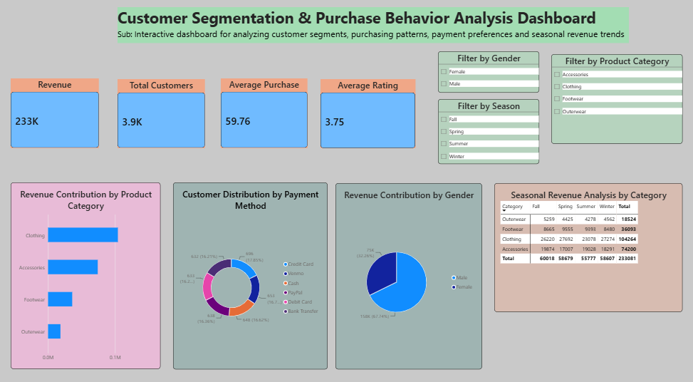
Dashboard Page 1 — Executive Business Overview
Core KPIs and revenue contribution across categories, payment methods and gender
$233K
Total Revenue
3.9K
Total Customers
$59.76
Average Purchase
3.75 / 5
Average Rating
Live dashboard built in Power BI with interactive filters for Gender, Product Category and Season.

Slide 5
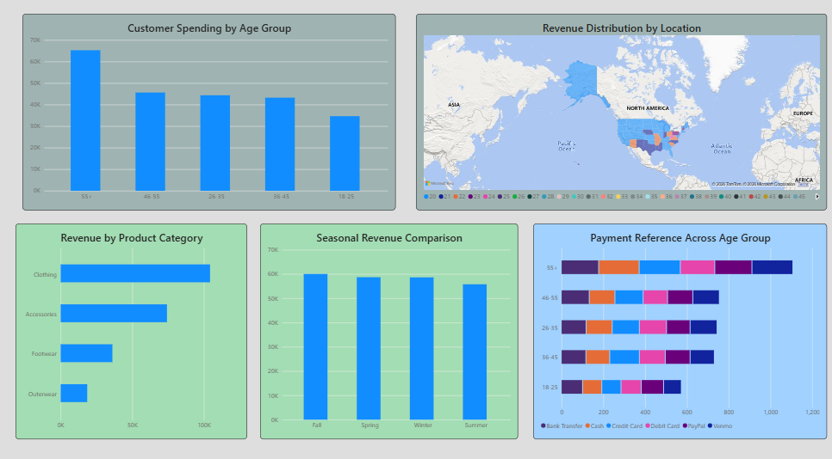
Dashboard Page 2 — Customer Behavior Analysis
Spending by age group, revenue by location, category and season
Customers aged 55+ spend the most, followed by a steady decline across younger groups.
Clothing leads category revenue; Outerwear trails the other categories.
Revenue stays broadly consistent across all four seasons.
Payment preference shifts noticeably by age group.
Live dashboard built in Power BI with interactive filters for Gender, Product Category and Season.

Slide 6
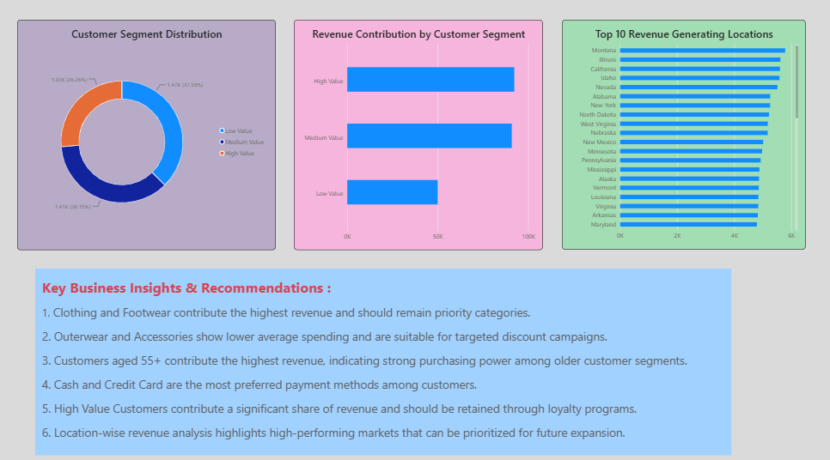
Dashboard Page 3 — Customer Segmentation & Recommendations
Segment distribution, revenue share and top revenue-generating locations
High Value customers (37.6%) form the largest segment by count.
High and Medium Value segments together drive most of total revenue.
Montana, Illinois and California lead the top 10 revenue-generating locations.
Live dashboard built in Power BI with interactive filters for Gender, Product Category and Season.

Slide 7






Key Findings
Insights derived from the dashboard.
Strong Revenue Base
Clothing Leads
Mature Buyers Spend Most
Total revenue is approximately USD 233K across approximately 3.9K customers.
Clothing is the leading revenue-generating category; Accessories and Footwear also contribute meaningfully.
Customers aged 55+ contribute the highest revenue, signaling strong purchasing power.
Value Segments Drive Sales
Stable Seasonality
Clear Priority Markets
High Value and Medium Value customer groups contribute the largest revenue share.
Revenue is relatively consistent across seasons, while payment preferences vary by age group.
Location-level analysis identifies priority markets for sales focus and inventory planning.

Slide 8


Business Recommendations
Actions supported by the analysis.
Retain High Value Customers
Grow Medium Value Customers
Loyalty rewards, early-access offers and personalized communication.
Bundles, cross-selling and targeted recommendations to move them upward.
Targeted Offers for Low Value
Prioritize Top Categories
Use focused coupons rather than broad discounting.
Ensure inventory availability and promotions for Clothing and other high performers.
Age-Specific Campaigns
Focus High-Revenue Locations
Tailor campaigns for the 55+ segment and match payment offers to preference.
Use top markets for regional marketing and expansion decisions.

Slide 9
Thank You
Customer Segmentation & Purchase Behavior Analysis · MySQL/phpMyAdmin & Power BI

